Slide 1
Prototyping high performance computing API to deposit and recover datasets - Kickoff Meeting Contract# - S15-072
April 8th, 2014

Slide 2
Agenda
Introduction
Objectives
Scope & Tasks
Key Stakeholders/Customers
Project Team Organization
Deliverables
Subcontracting/Invoice Procedures
Technical Points and Expectations
Risks and Dependencies
Communication
Open Questions

Slide 3
Introduction
NCI
Carl McCabe
Government Sponsor
Chief, Informatics and Scientific Computing Services Branch US National Cancer Institute’s Center for Bioinformatics & Information Technology
Phone: 240-276-7366
Email: Carl.McCabe@nih.gov

Slide 4
Introduction
Leidos Biomedical Research, Inc. (LBR)
Eric A Stahlberg – LBR ISP HPC Strategy Director
Information System Program Directorate
High-Performance Computing Strategy
Phone: 240.276.6729
stahlbergea@mail.nih.gov
Zhengwu Lu – LBR TPM
Technical Project Manager, Information System Program Directorate
Phone: 240-276-6487
Zhengwu.Lu@nih.gov
Matt Costello – LBR Subcontracts Administrator
Research Subcontracts
Phone: 301-846-6828
matthew.costello@nih.gov
Alexander Konev – LBR Contracting Officer
Research Subcontracts
Phone: 301-228-4323
konevas@nih.gov

Slide 5
Introduction
SVG Resources
Prasad Konka – POC, Software Architect
Phone: 703-431-1134
Prasad.konka@gmail.com
Eran Rosenberg – Scrum Master, Developer
eran.rosenberg@nih.gov
Mahi Narra – Software Developer
Durga Addepalli – Business Systems Analyst

Slide 6
Primary Objective
Establish new highly-reliable service to support management of mission critical and archival data
Motivations
Ease the burden of individualized data management
Enable greater value derived from generated data and datasets
Facilitate compliance with emerging data sharing requirements
Be more cost effective with purchases of storage

Slide 7
Secondary Objectives
Improve ease of use near-term and long-term
Provide stable means to deposit, access and recall managed data from the investigator and analyst perspective
Support mechanisms to annotate datasets
Position to align internal efforts with BD2K efforts
Technology agnostic interface for users of system
Derive greater value from datasets
Make metadata searchable
Enable extensions to metadata fields
Support remote access to available metadata

Slide 8
Secondary Objectives
Facilitate compliance with emerging data sharing requirements
Enable migration of datasets seamlessly to meet policy requirements
Foster utilization of external resources for sharing
Be more cost effective
Reduce unneeded copies of large datasets
Enable migration/staging of data to appropriate storage based on utilization
Improve dataset reuse based upon past dataset experiences

Slide 9
Scope
Establish services to support the general transfer of large datasets without requiring physical mounting.
Establish a pilot data set registration system to associate a label with a given managed dataset.
Establish easy-to-use methods for providing annotation information.
Establish a high-reliability storage model.
Obtain utilization statistics.
The developed APIs, associated dataset object repository, metadata and registration catalog database shall empower CBIIT in unifying its IT services, infrastructure and high performance computing architecture throughout NCI to support NCI enterprise business needs.

Slide 10
Tasks
Program Management
Source code repository, potentially GitHub
Project feature/backlog tracking, potentially custom JIRA
Monthly technical and financial reports
Status Meetings (weekly and as needed)
Project Summary Report
Prototyping Tasks
Requirements gathering and use case development
Plan to meet with 7 investigators/advisors in the month of
April 2015, prepare high level business use cases in: NGS
DNA, RNA, proteomics, or imaging analysis

Slide 11
Tasks
Prototyping Tasks
Assess technology
Design, prototyping, testing and implementation of proposed APIs
Analyze, conceptualize and design associated metadata, registration catalog database for the central HPC datasets object archive
Implement: Agile development approach with feature sets to be determined for development, demonstration, and testing in sprints
Provide HPC API/CLIs documentation as appropriate: User Guide, Technical Guide, Installation Guide, and Design Documentation.

Slide 12
Key stakeholders
Key Stakeholder | Team Member
NCI Government Sponsor (GS) | Carl McCabe
LBR ISP HPC Strategy Director | Eric Stahlberg
LBR Technical Project Manager (TPM) | Zhengwu Lu
Subcontractor Point of Contact | Prasad Konka
SVG Team | Prasad Konka, Software Architect Durga Addepalli – Business Systems Analyst Mahi Narra – Software Developer Eran Rosenberg – Scrum Master, Developer

Slide 13
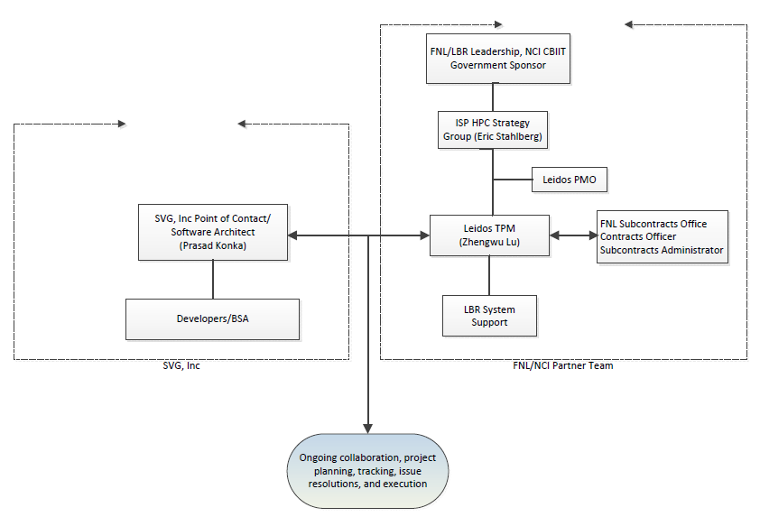
Project Team Organization
Project Organizational Structure

Slide 14
Deliverables
DELIVERABLE | DUE DATE
Project Deliverables
Monthly Technical and Financial Status Reports | 10th of each month
Project Summary Report | No later than 10 Days Before Project Completion
API Requirements Specification, API Design Specification, Metadata/Catalog Organization Specification | No later than 10 Days Before Project Completion
Software Codebase | No later than 10 Days Before Project Completion

Slide 15
Subcontracting
LBR Roles and Responsibilities
Contracting Officer
Only the Contracting Officer has authority to: (1) direct or negotiate any changes to the Statement of Work; (2) modify or extend the period of performance; (3) change the delivery schedule; (4) authorize reimbursement to the Subcontractor of any costs incurred during the performance of this subcontract; or (5) otherwise change any terms and conditions of this subcontract. All changes to the Statement of Work will be accomplished by bilateral modification to the subcontract.
Only the Contracting Officer as named above shall have the authority to prescribe changes to this subcontract or provide direction for which the Subcontractor will seek reimbursement. Any costs incurred by the Subcontractor not delineated herein or without the prior written approval of the Contracting Officer are incurred at the Subcontractor’s significant risk of non-payment.

Slide 16
Subcontracting
LBR Roles and Responsibilities
Contracting Officer’s Technical Project Manager (TPM)
The Contracting Officer’s TPM is responsible for: (1) monitoring the Subcontractor’s technical progress, including the surveillance and assessment of performance and recommending to the Contracting Officer changes in requirements; (2) interpreting the Statement of Work and any other technical performance requirements; (3) performing technical evaluation as required; (4) performing technical inspections and acceptances required by this subcontract; and (5) assisting in the resolution of technical problems encountered during performance.
Neither the TPM nor any person or entity other than the Contracting Officer possess any authority, implied or apparent, to provide direction that may cause or influence the Subcontractor to incur additional costs for which reimbursement may be sought. Any costs incurred by the Subcontractor not delineated herein or without the prior written approval of the Contracting Officer are incurred at the Subcontractor’s significant risk of non-payment.
Notes:
16

Slide 17
Subcontracting
LBR Roles and Responsibilities
Subcontracts Administrator
Serves as liaison between SVG and the LBR TPM. Additionally is responsible for administering, processing and handling contractual documentation.
Notes:
17

Slide 18
Invoice Procedures
Subcontractor POC prepare Monthly Status Reports – MSR (technical and financial)
Send to LBR TPM, Subcontracts Administrator
LBR TPM review, comment and approve MSR
Subcontractor receive and address comments from LBR TPM
Subcontractor send invoices monthly to LeidosBiomed@invoices.corcentric.com and cc: LBR TPM upon MSR approval (by LBR TPM)

Slide 19
Technology Points
Phase 1 – Robust, available and supportable
Phase 2 – Performance and optimization
Phase 3 – Technology change-out, extensibility and enhancements
Leverage existing technologies that meet technology constraints while fulfilling use case needs
Examine existing models for archive data management
Expect technologies to change
Object store technologies, NoSQL technologies, and more

Slide 20
Phase 1 - Aims
Define stable interface that meets near-term and long-term basic needs
Archive placement of dataset
Registration of dataset
Basic annotation of dataset
Location of datasets
Recall of datasets
A façade that is agnostic of underlying technology implementation
Robust and reliable as a core service
Designed for evolution of underlying technologies
Keep it simple

Slide 21
Phase 1 – Additional Topics
Data security
Inherent to protect the data placed in trust with the service
Data sharing
Prove utilization of other services being created for data sharing
Extensive metadata
Prove ability to support secondary metadata indexes
Dataset types
Agnostic of datatype
Driving initial use cases in genomics, imaging and biophysics

Slide 22
First Focus Areas in Phase 1
Use case information capture
Initial technology option selection
Draft interface definition
Leverage popular and de-facto standard interfaces to advise features (e.g. Amazon S3, Red Hat, etc.)
Describe use case scenarios using interface definitions
LBR TPM and the Subcontractor shall develop a feature set based schedule as needed and delivery of project deliverables
Keep it simple

Slide 23
Technical Expectations
Leidos TPM acts as key technical and customer focal point to perform project management, scheduling and arrange demonstrations
Subcontract POC works with BSA/Developers to ensure timely deliverable of required documents and contract deliverables.
Subcontract POC communicates with LBR TPM for guidance and direction on any issues that arise.

Slide 24
Risks and Dependencies
Risk / Dependency | Rating | Mitigation
Key personnel leave the program during POP. | Low | Provide supportive subcontractor management; work with LBR TPM to identify replacement resource.
The SVG team do not meet the timeline for required deliverables. | Medium | Work with SVG POC and members to establish a schedule for development as needed and delivery of project deliverables; communicate with SVG after each meeting to ensure team is meeting the planned schedule.
Scheduling of interviews and granting of access to infrastructure is delayed or blocked delays the timeline for required deliverables. | Medium | LBR TPM and LBR HPC Director to ensure rapid and effective communication with interviewees and slotting of interviews ASAP; also work on granting access to physical infrastructure for technical assessment/prototyping.

Slide 25
Communication
Meetings
Project Kick-off
Weekly Status Meeting
Meetings as Needed (Review Meetings, Individual Meetings, Task Review Board Meeting)
Ad-hoc meetings requested by LBR TPM
Project communication via potential custom JIRA tracker system
Consult with LBR ITOG/system team

Slide 26
Open Questions
Project Wiki location, development and maintenance
This may be unnecessary
?

